Slide 1
Lecture, CMPEN 472
Homework 6: Solution
1. Getting a number from keyboard (keyboard input, numbers)
2. Printing a number on terminal window (convert each digit to ASCII characters)
Time 20210301

Slide 2
Lecture, CMPEN 472
Homework 6:
1. Getting a number from keyboard (keyboard input, numbers)
2. Printing a number on terminal window (convert each digit to ASCII characters)
How to convert binary number for display, in binary, in decimal, and in hexadecimal?
How to convert ASCII representation of a number to a binary number?
Time 20210301

Slide 3
Lecture, CMPEN 472
Homework 6:
How to convert binary number for display, in binary, in decimal, and in hexadecimal?
How to convert ASCII representation of a number to a binary number?
Time 20210301

Slide 4
Lecture, CMPEN 472
Homework 6:
How to convert binary number for display, in binary, in decimal, or in hexadecimal?
1. Separate each digit – by dividing the number by 2, 10, or 16 and collecting the remainder
2. Convert the remainders to ASCII characters by adding ASCII bias
3. Then print the characters in reverse order (MSB first)
How to convert ASCII representation of a number to a binary number?
1. Take each character and subtract ASCII bias
2. Take each digit and multiply its weight:
a. 1,2,4,8,16,32,… for binary
b. 1,10,100,1000,10000,… for decimal
c. 1,16,256,4096, 65536,… for hexadecimal
3. Add all of the weighted numbers
Time 20210301

Slide 5




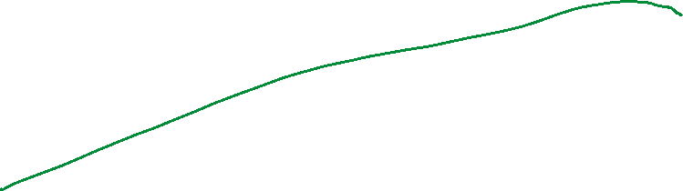
Lecture, CMPEN 472
Homework 6: Number Printing
Example of printing $6A from the content of accumulator A (hexadecimal print)
Time 20210229

Slide 6




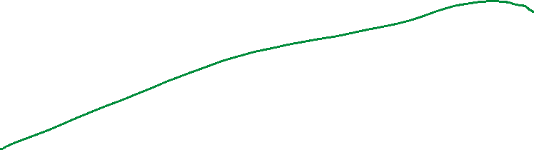
Lecture, CMPEN 472
Homework 6:
Example of printing $6A from the content of accumulator A (hexadecimal print)
accumulator A contains number %01101010=$6A=106
Time 20210229

Slide 7
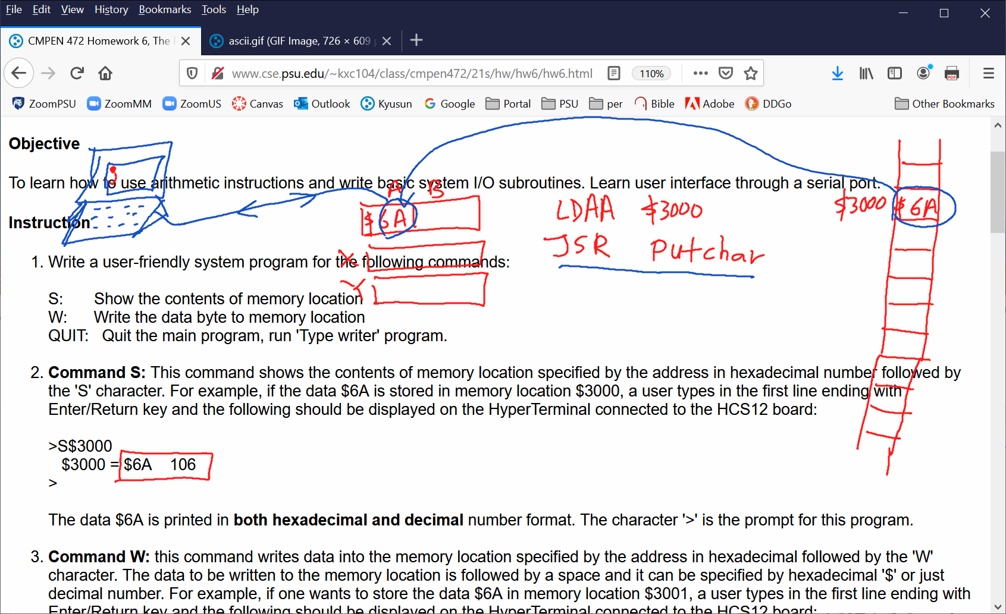
Lecture, CMPEN 472
Homework 6:
Time 20210229

Slide 8






Lecture, CMPEN 472
Homework 6: coding
Time 20210301

Slide 9
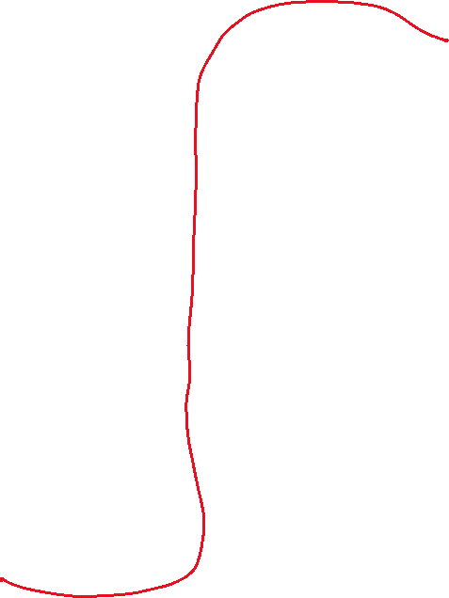




Lecture, CMPEN 472
Homework 6:
Time 20210301

Slide 10





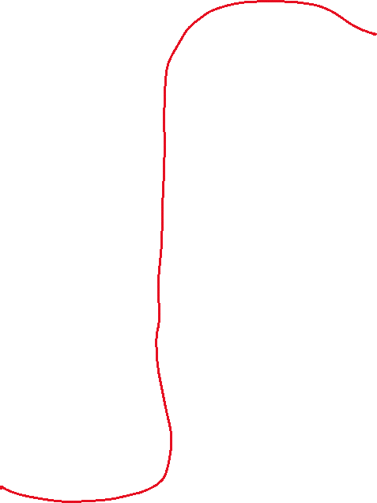
Lecture, CMPEN 472
Homework 6:
Time 20210301

Slide 11
Lecture, CMPEN 472
Homework 6:
Example of printing 106 from the content of accumulator A (decimal print)
accumulator A contains number %01101010=$6A=106
Time 20210301

Slide 12
Lecture, CMPEN 472
Homework 6:
Example of printing 106 from the content of accumulator A (decimal print)
accumulator A contains number %01101010=$6A=106
Keep dividing by 10 the number in accumulator A to separate the decimal digits:
If you collect the remainders after dividing by 10, you get the numbers 1, 0, and 6.
And you may convert them to ‘1’, ‘0’, and ‘6’ by adding the ASCII bias $30.
Time 20210301

Slide 13

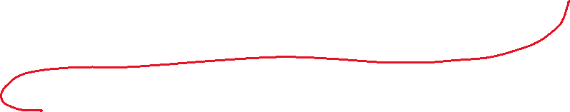




Lecture, CMPEN 472
Homework 6:
Time 20210301

Slide 14
Lecture, CMPEN 472
Homework 6: Code
; getting 3 decimal digits from accumulator A data
decprint
TAB
CLRA
LDX #10
IDIV
STAB $3004
TFR X,D
LDX #10
IDIV
STAB $3005
TFR X,D
LDX #10
IDIV
STAB $3006
; now all 3 decimal digits are done
BRA nx
nx:
LDAA #$30
ADDA $3006
JSR putchar
LDAA #$30
ADDA $3005
JSR putchar
LDAA #$30
ADDA $3004
JSR putchar
; now all 3 decimal digits are printed
RTS
Time 20210301

Slide 15
Lecture, CMPEN 472
Homework 6:
Time 20210301

Slide 16






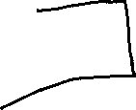



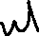









Lecture, CMPEN 472
Homework 6:
How to convert binary number for display, in binary, in decimal, and in hexadecimal
How to convert ASCII representation of a number to a binary number?
Time 20210301

Slide 17
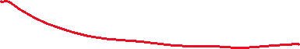
Lecture, CMPEN 472
Lectures:
Time 20210303

Slide 18

Lecture, CMPEN 472
Lectures:
Time 20210303

Slide 19
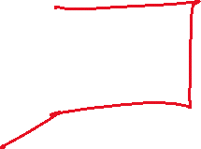





Lecture, CMPEN 472
Lectures:
Time 20210303

Slide 20







Lecture, CMPEN 472
Lectures:
Time 20210303

Slide 21
Lecture, CMPEN 472
Homework 6:
Questions – number (decimal or hexadecimal) entering (keyboard)
– number (decimal or hexadecimal) display (printing on screen)
Time 20210305

Slide 22
Lecture, CMPEN 472
Homework 6: Keyboard Input
Number
How to convert binary number for display, in binary, in decimal, or in hexadecimal?
How to convert ASCII representation of a number to a binary number?
1. Take each character and subtract ASCII bias
2. Take each digit and multiply its weight:
a. 1,2,4,8,16,32,… for binary
b. 1,10,100,1000,10000,… for decimal
c. 1,16,256,4096, 65536,… for hexadecimal
3. Add all of the weighted numbers
Time 20210301

Slide 23
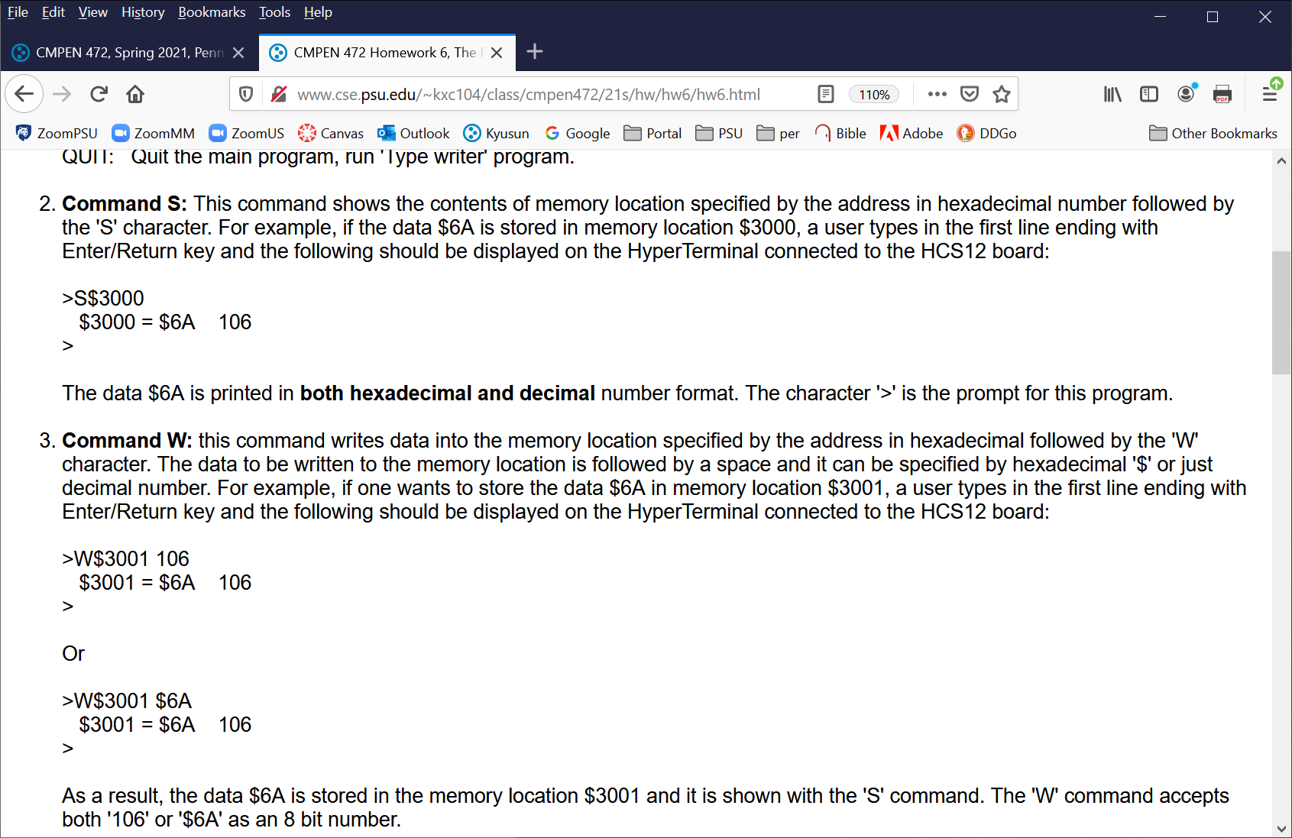








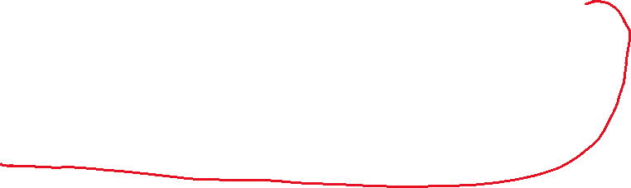

Lecture, CMPEN 472
Lectures:
Quiz 20210303:
Time 20210303

Slide 24

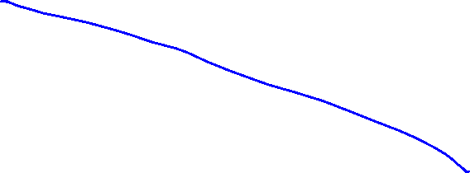




Lecture, CMPEN 472
A
B
$
$3000
ORG $3100
START LDS #$3100
$
1
D
$
$
$
2
X
$
$
3
$
4
Y
$
$
5
SP
$
$
6
$
7
PC
$
$
$3008
$
9
CCR
$
A
S X H I N Z V C
$
B
$
C
$
D
$
E
$
F
$
$3010
$
1
Time 20210226

Slide 25







Lecture, CMPEN 472
A
B
$
$3000
ORG $3100
START LDS #$3100
$
1
D
$
$
$
2
X
$
$
3
$
4
Y
$
$
5
SP
$
$
6
$
7
PC
$
$
$3008
$
9
CCR
$
A
S X H I N Z V C
$
B
$
C
$
D
$
E
$
F
$
$3010
$
1
Time 20210226

Slide 26




Lecture, CMPEN 472
A
B
$
$3000
ORG $3100
START LDS #$3100
$
1
D
$
$
$
2
X
$
$
3
$
4
Y
$
$
5
SP
$
$
6
$
7
PC
$
$
$3008
$
9
CCR
$
A
S X H I N Z V C
$
B
$
C
$
D
$
E
$
F
$
$3010
$
1
Time 20210226

Slide 27
Lecture, CMPEN 472
Homework 6: Code
Keyboard Input
keyin1 LDAA $3000
CMPA #$30
BLO err
CMPA #$39
BHI alph1
SUBA #$30
STAA $3005
BRA keyin2
Alph1 CMPA #$41
BLO err
CMPA #$46
BHI err
SUBA #$37
STAA $3005
BRA keyin2
keyin2 LDAA $3001
CMPA #$30
BLO err
CMPA #$39
BHI alph2
SUBA #$30
STAA $3006
BRA keyin3
Alph2 CMPA #$41
BLO err
CMPA #$46
BHI err
SUBA #$37
STAA $3006
BRA keyin3
A
B
$
$3000
D
$
$
$
1
$
2
X
$
$
3
$
4
Y
$
$
5
SP
$
$
6
$
7
PC
$
$
$3008
$
9
CCR
$
A
S X H I N Z V C
$
B
$
C
$
D
$
E
$
F
$
$3010
$
1
Time 20210226

Slide 28
Lecture, CMPEN 472
Homework 6: Code
Keyboard Input
keyin3 LDAA $3002
CMPA #$30
BLO err
CMPA #$39
BHI alph3
SUBA #$30
STAA $3007
BRA keyin4
Alph3 CMPA #$41
BLO err
CMPA #$46
BHI err
SUBA #$37
STAA $3007
BRA keyin4
keyin4 LDAA $3003
CMPA #$30
BLO err
CMPA #$39
BHI alph4
SUBA #$30
STAA $3008
BRA keyinD
Alph4 CMPA #$41
BLO err
CMPA #$46
BHI err
SUBA #$37
STAA $3008
BRA keyinD
A
B
$
$3000
D
$
$
$
1
$
2
X
$
$
3
$
4
Y
$
$
5
SP
$
$
6
$
7
PC
$
$
$3008
$
9
CCR
$
A
S X H I N Z V C
$
B
$
C
$
D
$
E
$
F
$
$3010
$
1
Time 20210226

Slide 29
Lecture, CMPEN 472
Homework 6: Code
Keyboard Input
keyinD LDAA $3005
LSLA
LSLA
LSLA
LSLA
ADDA $3006
STAA $300A
LDAA $3007
LSLA
LSLA
LSLA
LSLA
ADDA $3008
STAA $300B
LDX $300A
RTS
A
B
$
$3000
D
$
$
$
1
$
2
X
$
$
3
$
4
Y
$
$
5
SP
$
$
6
$
7
PC
$
$
$3008
$
9
CCR
$
A
S X H I N Z V C
$
B
$
C
$
D
$
E
$
F
$
$3010
$
1
Time 20210226

Slide 30
Lecture, CMPEN 472
A
B
$
$3000
ORG $3100
START LDS #$3100
$
1
D
$
$
$
2
X
$
$
3
$
4
Y
$
$
5
SP
$
$
6
$
7
PC
$
$
$3008
$
9
CCR
$
A
S X H I N Z V C
$
B
$
C
$
D
$
E
$
F
$
$3010
$
1
Time 20210226

Slide 31
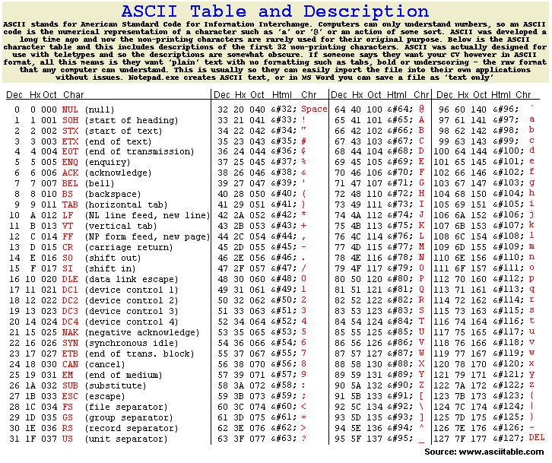
Lecture, CMPEN 472
Lectures:
Time 20210303

